Slide 1
Prototyping and Emulation Studies of Large-Scale 5G Wireless Systems
Team 35:
Andrew Whitehead, Dazhawn Davis, Ousmane Ntutume, Nolan Cardona, Rohan Willis
Website: https://sdmay20-35.sd.ece.iastate.edu/
Advisor/Client: Hongwei Zhang, Mattias
Notes:
Nolan

Slide 2
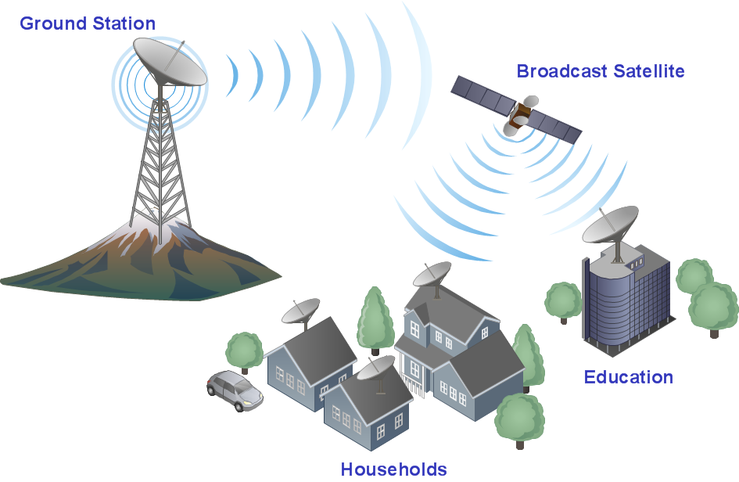
Project Overview
OpenAirinterface(OAI) provides open-source (software and hardware) wireless technology platforms
We will implement Physical Abstraction layer into new branch
Notes:
Rohan

Slide 3
Project Plan
OUSMANE LIOYD NTUTUME
Important Tasks:
Task 1: Research 5G networking
Task 2: Install necessary software (Ubuntu and Virtualbox)
Task 3: Practice conducting simulations of the template and provided code in OpenAirInterface repository
Task 4: Document results
Notes:
lloyd

Slide 4
Project Plan - CONT.
Task 5: Isolate differences of version v0.5.2 and v1.1.0
Task 6: Using found differences and research done, implement the PHY abstraction layer
Task 7: Test speed of emulation and improve if needed
Notes:
Andew

Slide 5
Expected end product and Deliverables
As we complete this project, we are expected to provide our client with:
Demonstration and performance evaluation of existing OpenAirInterface simulation/emulation systems
Detailed design and implementation of the Physical Layer Abstraction
Operation of efficient device-to-device communication, as well as the use of the enhanced system for studying 5G wireless solutions
Notes:
Nolan

Slide 6
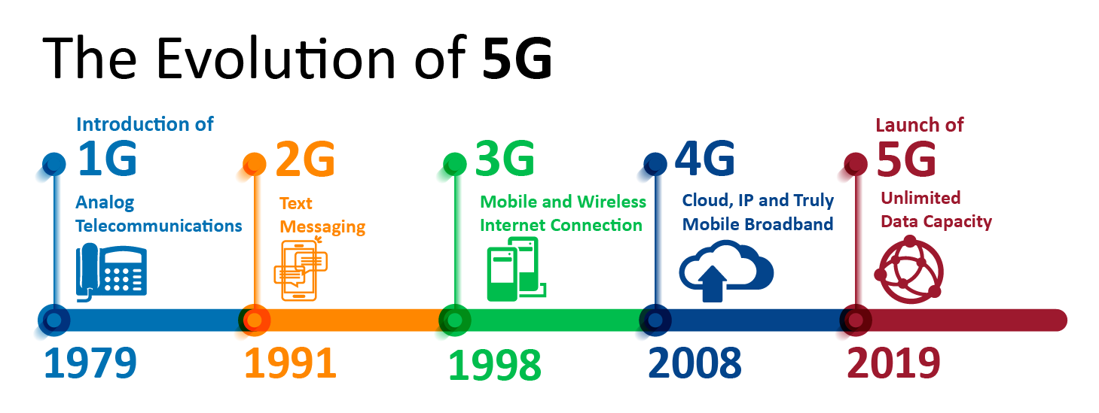
What is 5G
5G is the next generation of mobile broadband that will eventually replace, or at least augment, your 4G LTE connection. With 5G, you’ll see exponentially faster download and upload speeds. Latency, or the time it takes devices to communicate with the wireless networks, will also drastically decrease.
Offer significantly faster data speeds.
Notes:
Rohan

Slide 7
Importance/Impact of 5G Systems
It has the potential to transform the lives of people around the world.
Common uses
Autonomous vehicles
Cable Streaming
Remote device control
Life Changing Applications
Public safety and infrastructure
Health care
Notes:
Rohan

Slide 8
Technical limitation/Considerations
Limitations
Download correct ISO image and Kernel to support needed capabilities
Ubuntu version 14.04 for v0.5.2
Ubuntu version 16.04 for v1.1.0
Utilize the most recent version of the 5G code which includes Device to Device Communication ability
Assumptions
Physical Abstraction layers must allow for simultaneous simulations
Minimal code will be added to the existing code revision
All Code that will be implemented must be documented appropriately
Notes:
Andrew

Slide 9
Potential risks and mitigation
Ubuntu Linux machine was missing required commands when initially downloaded
Expected output from the simulations that was run displayed incorrect characters
Command line to run code wasn’t functioning properly due to revision of linux machine
Understanding of code needs to be assessed
Missing variables when attempting to run the simulation
Not knowing the OAI commands to install the dependencies
Learning what settings needed in a xml file to run a simulation
Learning what options we should use when running a simulation
Notes:
Dazhawn

Slide 10
Project Milestones and schedule
Learning what classes/functions are called to utilize the physical abstraction layer(adding print statements into v0.5.2 and v1.1.0 to see what functions are called and comparing the differences)
Editing v1.1.0 to call the physical abstraction layer(moving the functions and calls from v0.5.2 to v1.1.0 to implement the layer)
Running testing to make sure that the physical abstraction layer is called(comparing the log files to make sure they both have the same function calls)
Testing the results of running simulations with/without physical abstraction layer(it was reported by OAI that when implementing layer 1 into later versions you get lag. Making sure there is no lag, find how they are evaluating the SINR, etc..)
Notes:
Dazhawn

Slide 11
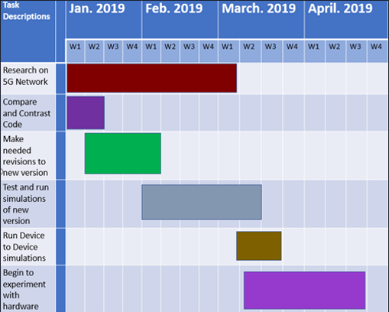
Schedule goal

Slide 12
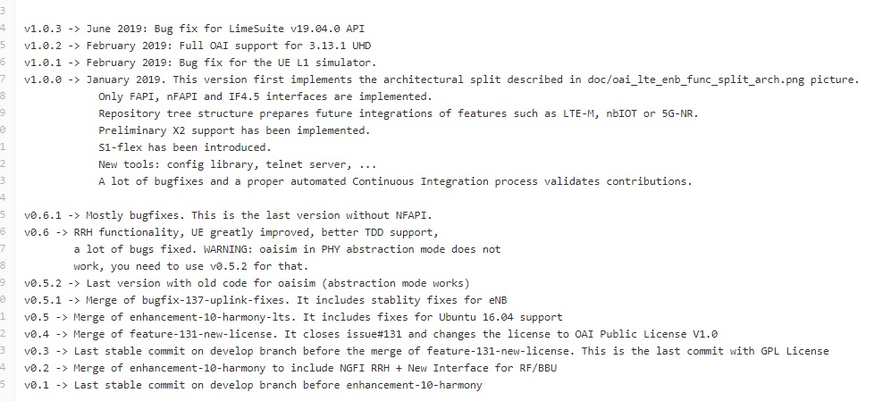
System design
Version Decisions
Notes:
Nolan

Slide 13
Version Decisions continue
Notes:
Nolan

Slide 14
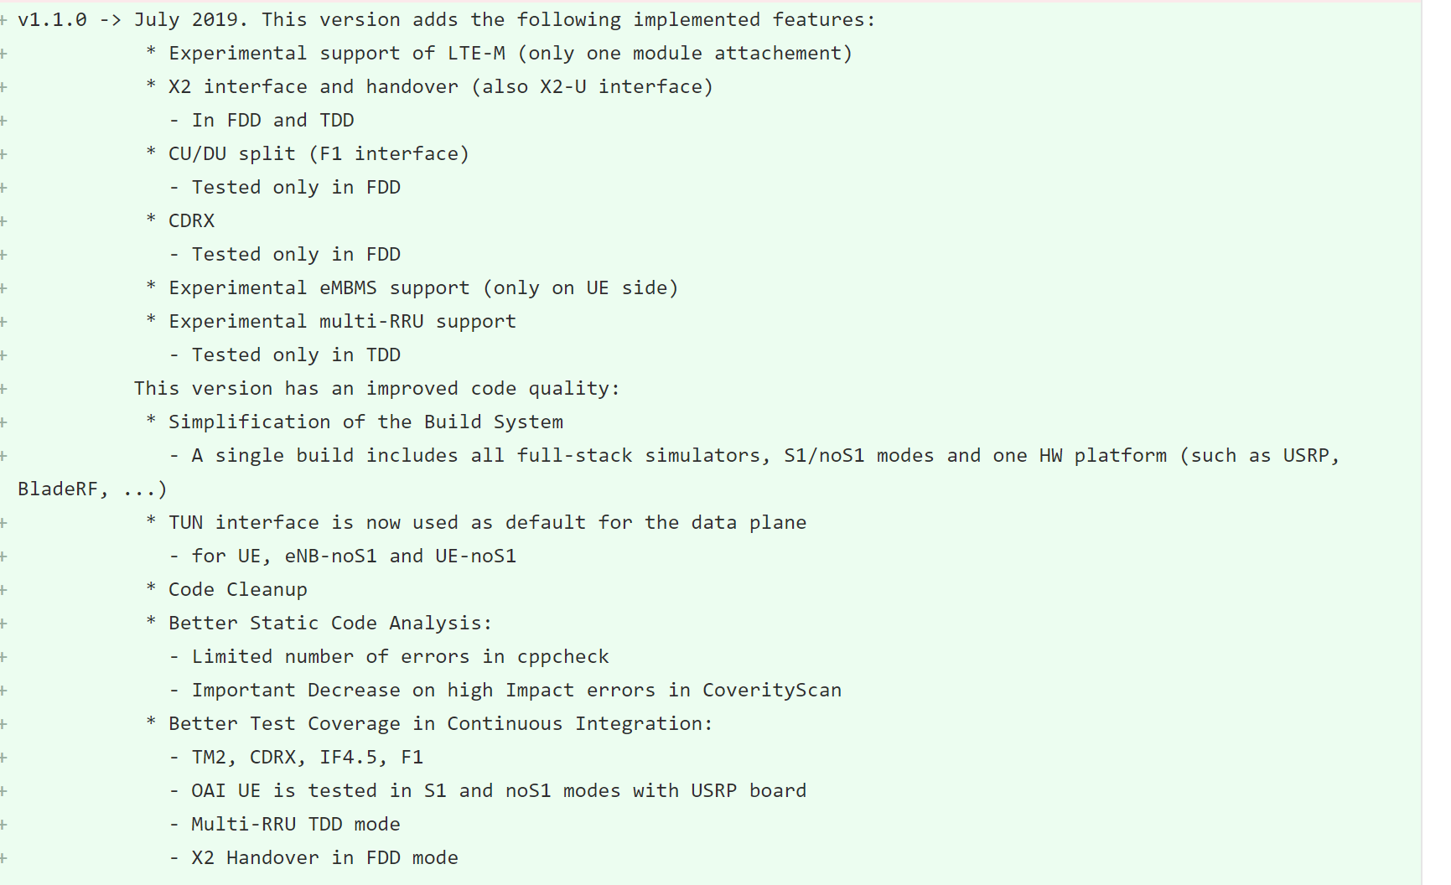
Version Decisions continue
Notes:
https://gitlab.eurecom.fr/oai/openairinterface5g/commit/6b16efcb0cb92963bc499b6a95bd66c3dc7d9a1d#fda3484edf8db0684440157ce0b110d784d42704
Nolan

Slide 15
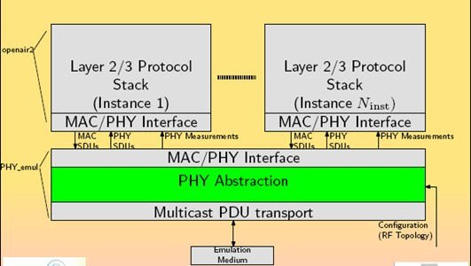
Detailed design for the specific Layers of 5G
OUSMANE LIOYD NTUTUME
Notes:
lloyd

Slide 16
PHY Abstraction Layer
Benefits
Lower computational complexity
Lower simulation time
Relevant Functionalities:
Channel modeling
Interference modeling:
Radio modeling:
OUSMANE LIOYD NTUTUME
Notes:
lloyd

Slide 17
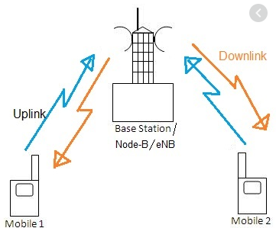
Physical layer channeling decomposition
Downlink channel
Uplink channels
OUSMANE LIOYD NTUTUME
Notes:
Compare and contrast 0.5.2 and 1.1.0 mac_phy_primitives files.
Reason: attempt to bring over code from previous version so it’ll work in the 1.1.0 version
lloyd

Slide 18
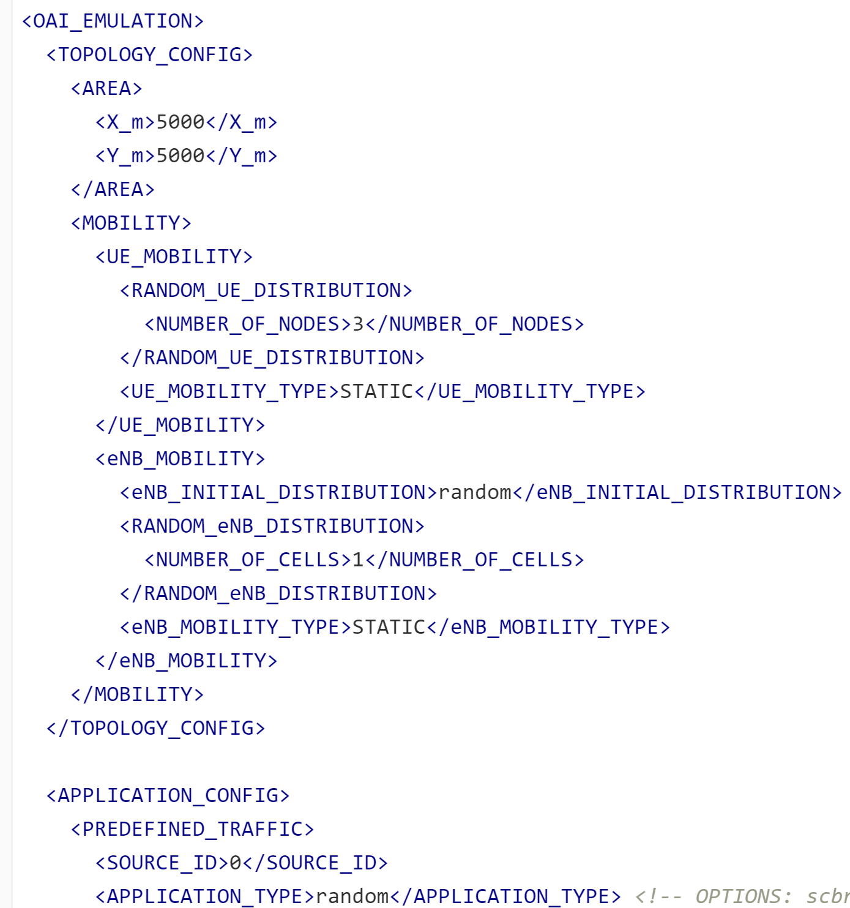
Test Plan
The test are performed through running a command and xml files(emulation)
Have to run a lot of different settings with test.(Such as area,
Number of nodes, ue mode, number of cells, time,etc..)
Try and emulate for longer periods of time.(running test for a
Short period of time is easy. The longer the simulation time
The higher the SINR and BLER will be causing more problems)
Notes:
Dazhawn

Slide 19
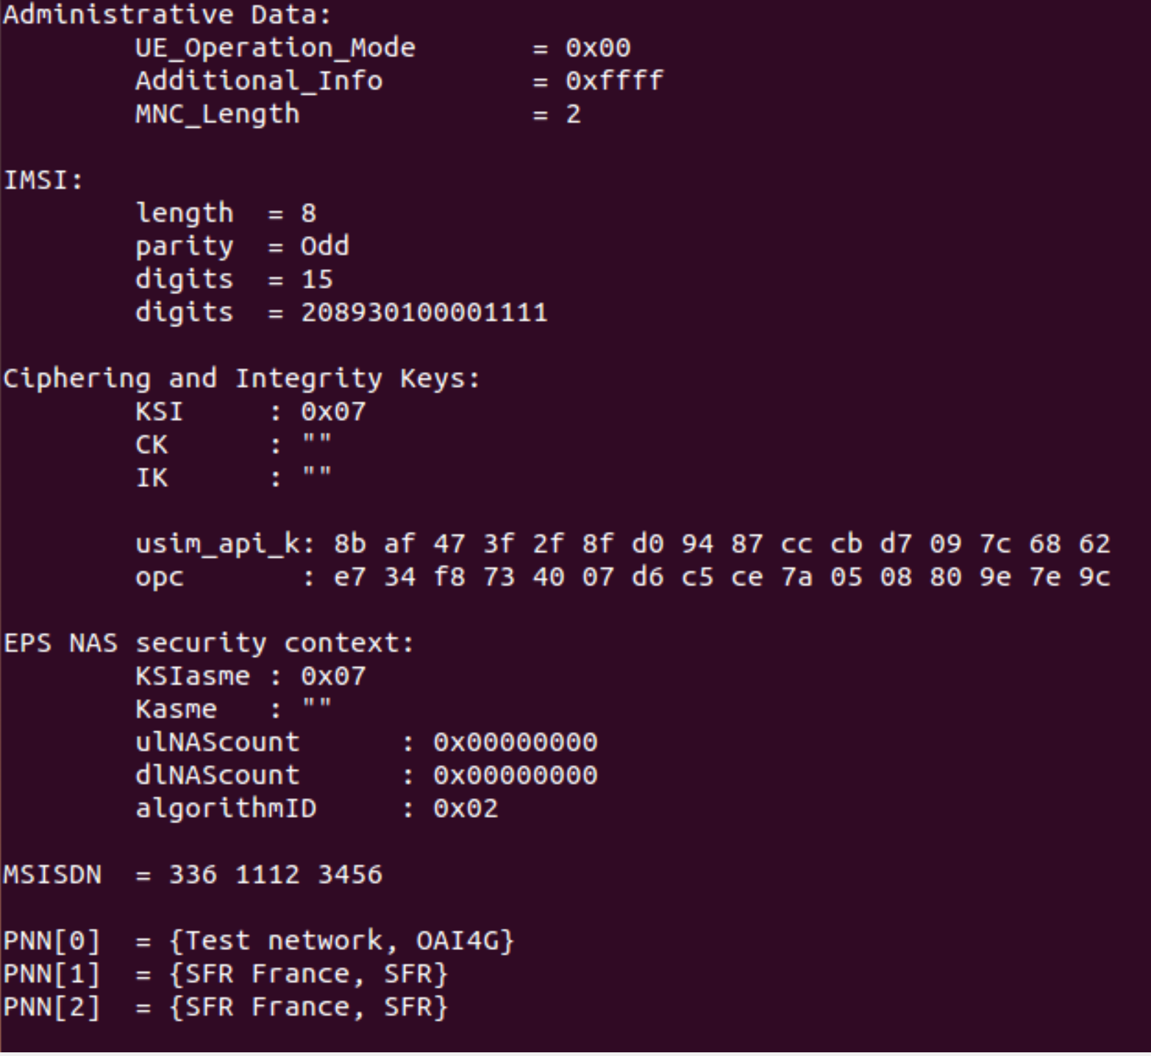
Engineering Standards and Design Practices
OAI
Open source application that had previous versions of program on it
The interface needed to run programs using 5G
Git Bash
Git commands used to analyze differences in software and execution methods among the versions
Ubuntu
Open source operating system
Allowed for execution of project’s .c and XML files
Notes:
Talk about OAI
Andrew

Slide 20
Contributions
DaZhawn Davis - Chief Engineer
Andrew Whitehead - Test Engineer
Nolan Cardona - Report Manager
Rohan Willis - Informational Specialist
Ousmane Lioyd Ntutume - research manager
Notes:
All

Slide 21
Thank You!
Team 35:
Andrew Whitehead, Dazhawn Davis, Ousmane Ntutume, Nolan Cardona, Rohan Willis
Website: https://sdmay20-35.sd.ece.iastate.edu/
Advisor/Client: Hongwei Zhang, Mattias
Notes:
Rohan

